Slide 1
Introduction and Course Overview
Agentic Coding for Geospatial
Ujaval Gandhi
Spatial Thoughts
ujaval@spatialthoughts.com

Slide 2





Spatial Thoughts
A learning platform for modern geospatial technologies.
Free and open learning content for QGIS, Python, GDAL and Google Earth Engine.
Learning materials used by 1 million+ users every year.
All material is licensed under CC-BY allowing anyone to use and adapt for free
Online academy for cohort-based instructor-led classes.
Trained participants from over 100 countries.
www.spatialthoughts.com

Slide 3

Introduction
Background in GIS and Remote Sensing
Intern at Indian Institute of Remote Sensing (IIRS), Dehradun, India
MS in Geospatial Information Engineering from University of Wisconsin - Madison, USA
15 years of professional experience
One of the early employees at Google Inc.
Built large scale data processing pipelines for Google Earth
Led the team responsible for satellite and aerial imagery for Google Maps
Developed expertise in Google Earth Engine and trained 1000+ scientists and researchers across India
Presently
Left Google in 2020 to work on startup Spatial Thoughts.
Building open-source content and helping people master advanced geospatial skills.
Ujaval Gandhi

Slide 4

Introduction
Masters in Remote Sensing
Interest in Automating Workflows
Training Associate
Class logistics
Project support
Vigna Purohit

Slide 5
Course Overview
Module 1
Getting Started with Agentic Coding
Module 2
Building Complex Workflows
First Steps with Claude Code
Application 1: Geospatial Data Analysis (Mapping Crime Hotspots)
Application 2: Using Web APIs (Route Optimization)
Agent Skills

Slide 6
Course Overview
Module 3
AI Second Brain
Module 4
GeoAI
Application 3: Building a Personal Knowledge Website
MCP Servers
Application 4: Object Detection using Deep Learning

Slide 7
Assignment and Evaluation
Module 1
Module 2
Assignments
Module 3
Module 4
Class Exercises
Live Quizzes
Assignment 1*
(1-2 hours)
Class Exercises
Live Quizzes
* Assignment is due on the last day of the course

Slide 8
Live Session Structure
All the live sessions are hands-on.
We will have 10-15 minutes of explanation of a concept, followed by a 5-minute exercise
All participants are expected to complete the exercises during the class.
You can ask questions at any point during the session. Just unmute and ask, or use the chat.
We will have 1 break of 10 minutes during each 3-hour session.
All sessions are recorded and will be shared with the participants. If you miss any session, watch the recording and submit the exercises by email.

Slide 9
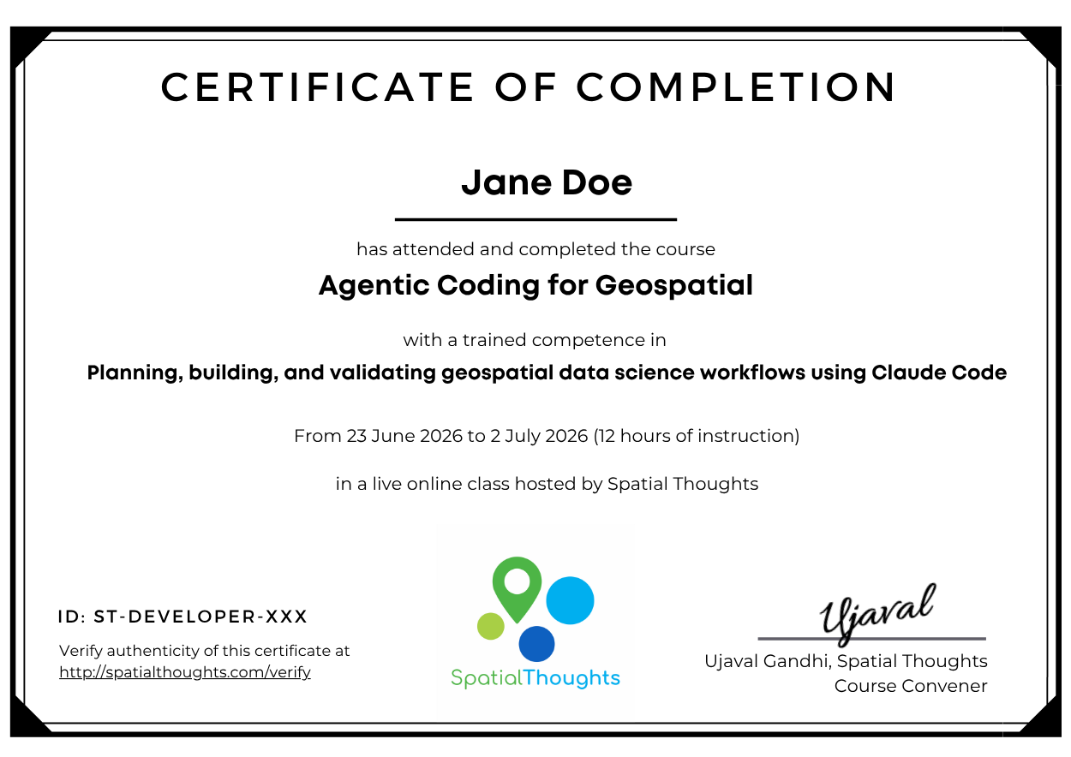
Certification
Each participant would be given a certificate of completion
Certificates are issued by Spatial Thoughts and come with a unique ID that can be verified at spatialthoughts.com/verify
Participants must be enrolled in a course and complete the exercises and assignment to earn the certificate.
If you miss a class, you should submit the exercises by email for evaluation.

Slide 10
Introduction to Agentic Coding

Slide 11
AI Agents
Agents are software systems that are able to complete tasks on behalf of the users.
Instead of user prompting the model at each step for a response, Agents can plan, execute multi-step workflows.
The core principle is the ReAct loop (reasoning and acting) [reference]
Reason → Act → Observe → Repeat

Slide 12
Agentic Coding
Agentic coding involves setting high-level goals than line-by-line prompts or copy/pasting code from AI Assistants.
The agent plans a coding task, executes changes across multiple files, runs the code, fixes errors, checks the outputs and iterates based on results.
If the code throws an error, the agent reads the output, reasons through the failure, and applies a fix on its own
This paradigm shifts the developer's role from writing every line to reviewing, directing, and validating the agent's work.

Slide 13
Agent Harness
LLMs themselves can only generate a response from a prompt.
You need a system that can use LLMs to perform agentic codings tasks. This system is the “Agent Harness”.
Harness turns LLMs into Agents
Agent = Model + Harness

Slide 14
Key Features of a Agent Harness
Tool Access
Has access to tools to manage code (i.e. Git), run shell commands, call APIs etc.
Memory
Has context on the previous executions and user preferences
Workspace
Has access to files, runtime environment and operating system
Guardrails
Has the ability to manage permissions, and enforce policies

Slide 15
Claude Code
Claude Code is the agentic harness around Claude models by Anthropic.
One of the most popular coding agent in the market.
It is a closed-source system that is tightly integrated with Claude models and Anthropic APIs.
Other competitors to Claude Code include
OpenAI Codex
Gemini CLI
GitHub Coilot CLI
The ecosystem is more-or-less standardized on the feature set.
Cost and Model performance are the key factors in determine your choice of agent harness.

Slide 16
Open Source Coding Agents
Many open-source alternatives exists that provide similar functionality.
OpenCode
Pi
DeepSeek Harness
Model choice and flexibility are the main factors driving adoption of open-source harnesses.
You can pick from a wide range of models
You can use local models running on your own machine
You get a lot more visibility and transparency on the execution flow.

Slide 17
Let’s get coding

Slide 18
Get the Workshop Materials
Workshop materials are available at
https://courses.spatialthoughts.com/agentic-coding-geospatial.html

Slide 19
Introduction to Markdown

Slide 20
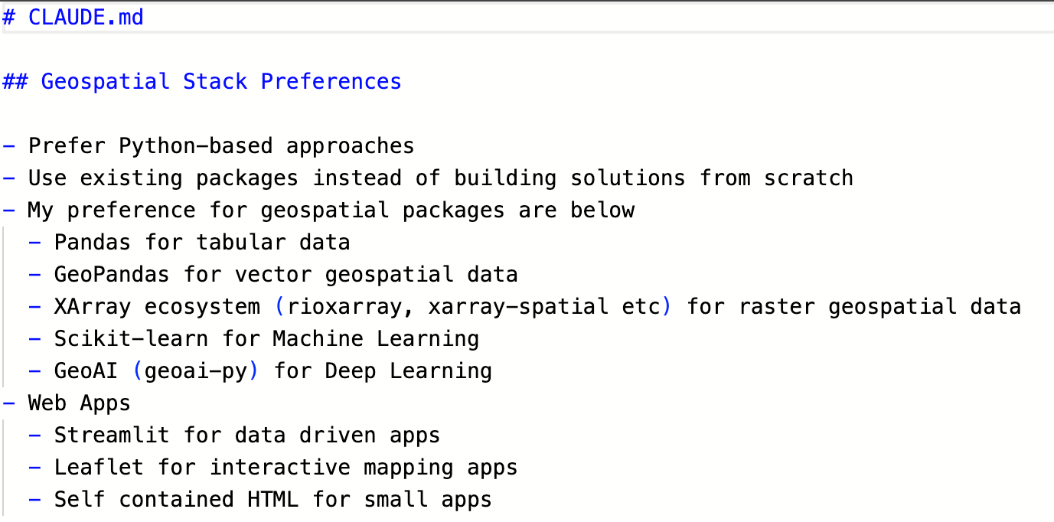
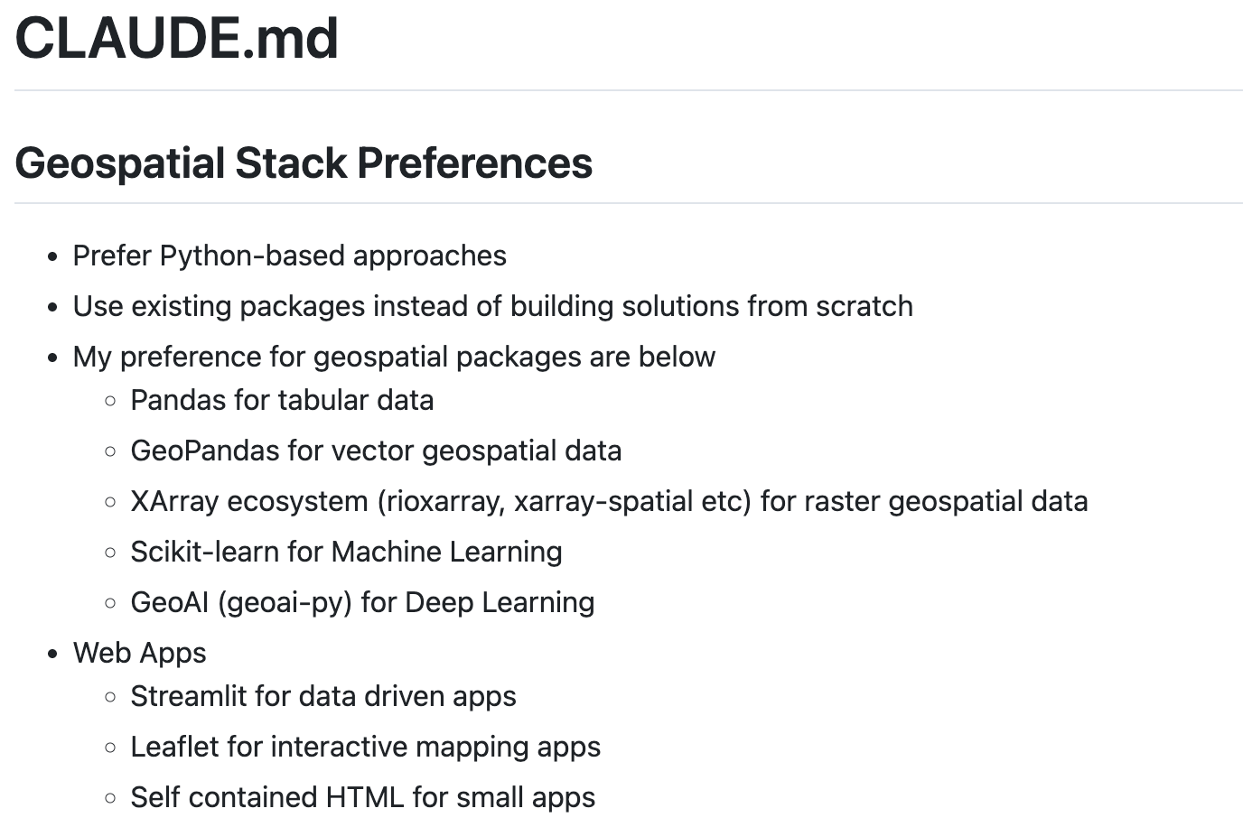
Markdown
Markdown Text
Markdown is a simple formatting language to create structured documents.
Plain text formatting that is easy to read and write for humans and computers.
It is a widely used standard for creating documents and websites
Markdown documents can be easily converted to other formats (PDF, Word, HTML) without worrying about styling and format-specific formatting.
Rendered HTML

Slide 21
Flavors of Markdown
The original Markdown specifications supports basic syntax - which is limiting for many applications.
There is a superset of Markdown that support an extended syntax.
Tables
Code Blocks
Footnotes
…
GitHub supports the GitHub-flavored Markdown syntax which supports the full extended syntax, plus some GitHub-specific additions.
Tip, Notes, Alerts
Diagrams, Mathematical expressions
Referencing GitHub issues, users

Slide 22
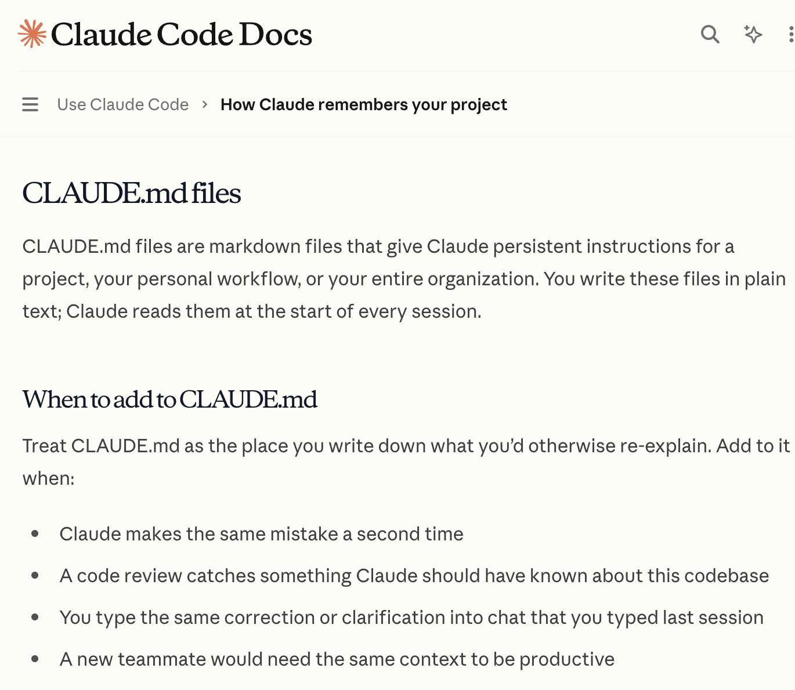
Markdown is the language of AI
AI systems use Markdown as a native format to structure content
Markdown is easier for LLMs to parse and makes them more effective than HTML/PDFs
Markdown in prompts helps AI recognize structure and prioritize instructions.
Headings, bullet points, tables convey useful structure information
Agentic systems like Claude Code use Markdown as the language for configuration.

